Slide 1
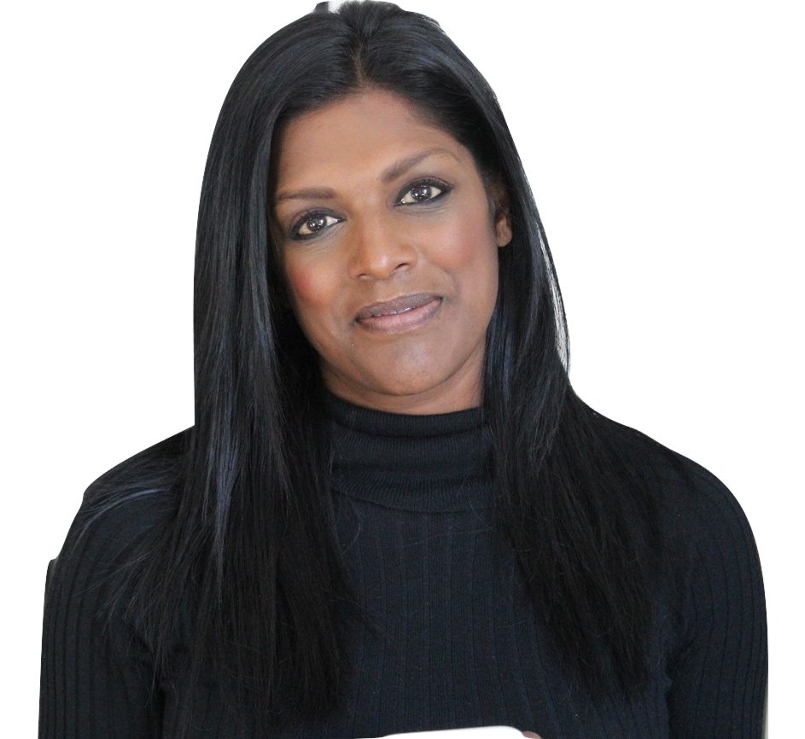
Create your own online course
Visibility School FREE class
Liz Nead
Your visibility expert!

Slide 2

Choose a topic
STEP ONE
Focused and narrow
Solves a problem
Reinforces your expertise
Creates urgency

Slide 3

Create freebie
STEP TWO
Something juicy
Reinforces expertise
Gets you excited and talking
Includes bio and services

Slide 4

Create FB event
STEP THREE
Consistent with everything
A place for people to find out
Samples and invites
Cross posting

Slide 5

Create sign up
STEP FOUR
Mailchimp or Google Forms
Add video and header
Easy to sign up
Good info flow

Slide 6

Marketing plan
STEP FIVE
FB lives with preview
Info in group
Post everywhere
Highlight sign ups!
Be bold

Slide 7

Digital Download
STEP SIX
Good information to follow along
Could include presentation
Keep the branding
Include bio and marketing

Slide 8

Reminder System
STEP SEVEN
Keep it personal
Keep it exciting
Find out what they want
1 week, 1 day, 1 hour

Slide 9

Execute Course
STEP EIGHT
Not too long- stick to outline
Don’t give away everything
Don’t forget to promote
Record for evergreen

Slide 10

Follow up
STEP NINE
Engagement is opportunity
Create a system
Don’t give up!
Invite to the next

Slide 11
Are you ready for visibility school?
Thank you!
Starts May 7
6 weeks with Liz
$199 or 2 pay – $125

